Slide 1
Pavan Jwala Project
Call for a Great Investment Opportunity
Notes:
Not a donation, not a loan – something much better
You will get more than your money back
You will help the Temple

Slide 2
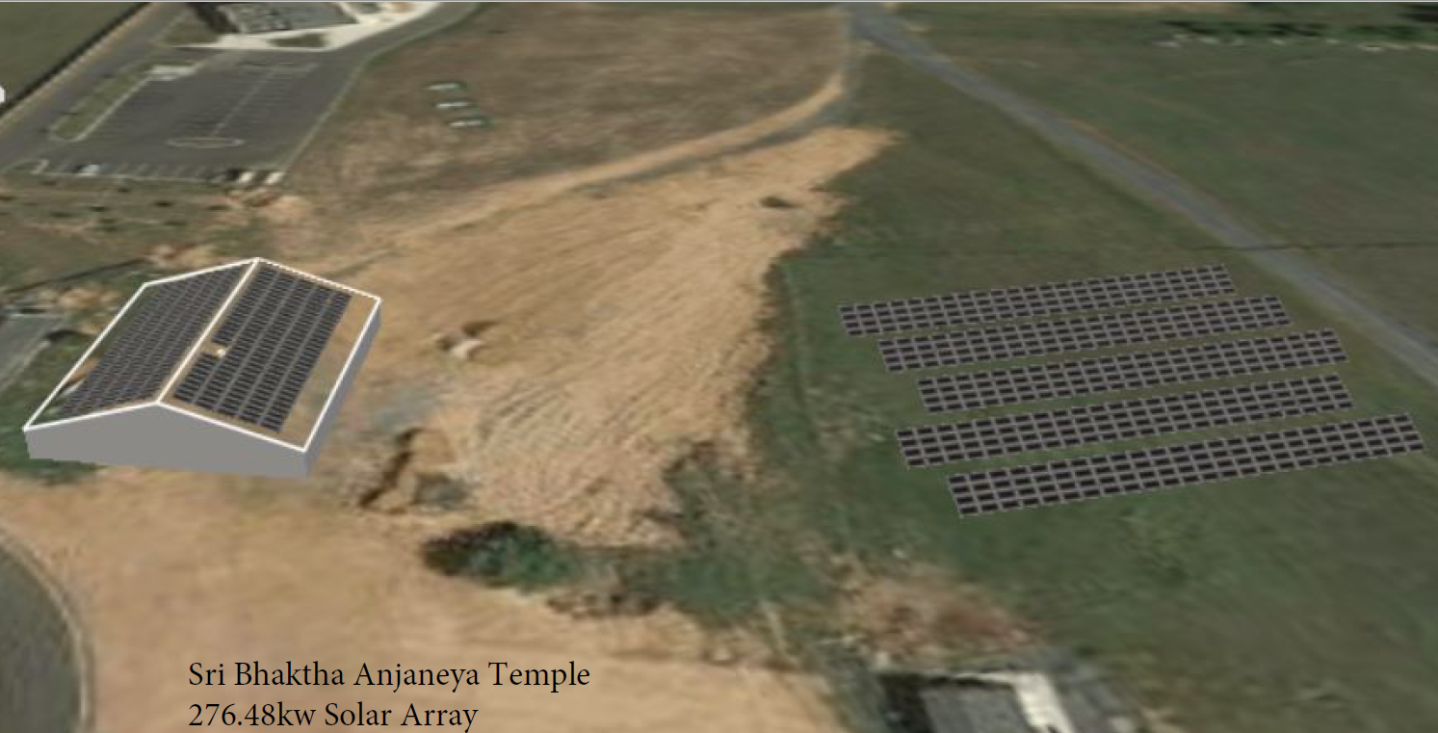
Panels on barn roof and ground Provides 100% of electric use at Temple, barn, all houses
Notes:
Temple, barn, all 5 priest houses, 2 houses on fingerboard rd, adjacent property
Used land based panels to meet 100% of the needs, 1-2 acres, plenty of land
System can be expanded when Phase II is over by expanding the land component

Slide 3
Investment Details
Cost ~ $580,000
Temple annual electric bill ~$40,000
Investment eligible for MACRS 5 year depreciation/Bonus depreciation
Investment eligible for 30% federal solar investment tax credit
Potential state incentives ~$20,000
Project has to be started in 2019 to avail the above incentives, some reduced next year
System warranted for 25 years
Notes:
We have proposals from 3 vendors, we have short listed to two, we plan to select one in the next week
We will form a partnership to collect the investors’ contribution and stop when we get the capital needed. Some are interested.

Slide 4
Benefits
Temple
Pay the same electric charges to investors instead of utility
Free electricity for 15-20 years (after payoff to investors)
Does not have to worry about utility rate increases in the future
Investors’ investment frees Temple to get best rates for Phase II and future funding needs
Investors
Significant tax benefits
Federal tax credit, State incentives
Bonus depreciation
Solar Renewable Energy Certificate (SREC) incentives
Help sustain the Temple, financially and in energy use
Create sustainable environment for the future generations
Notes:
The income, expenses, and credit flow from partnership to individual investors through K-1s.

Slide 5
More Information
Brochure and Volunteers available at this meeting, please ask
You can also contact:
Sriram Srinivasan, 571-265-9427
Raj Rajagopal, 703-283-2102
Raghu Janamanchi, 703-598-1577
Nandini Mouli, 443-691-7664
Venkatachalam, 240-476-9431
Thyagu Sastrigal, 301-257-4126, Thyagu@sbat.org

